Slide 1
The Effect of Movie Lead’s Gender on Movie’s Revenue
Xiaoxuan (Hayley) Gu
Chaiyapuk (KK) Titinanapun
Xinwen (Gabriel) Wu
Anyi (Aprill) Zhao
Jiaying (Grace) Zheng
Yue (Lydia) Zou
Nov 29, 2022
Notes:
Present our group project

Slide 2
Background

Slide 3
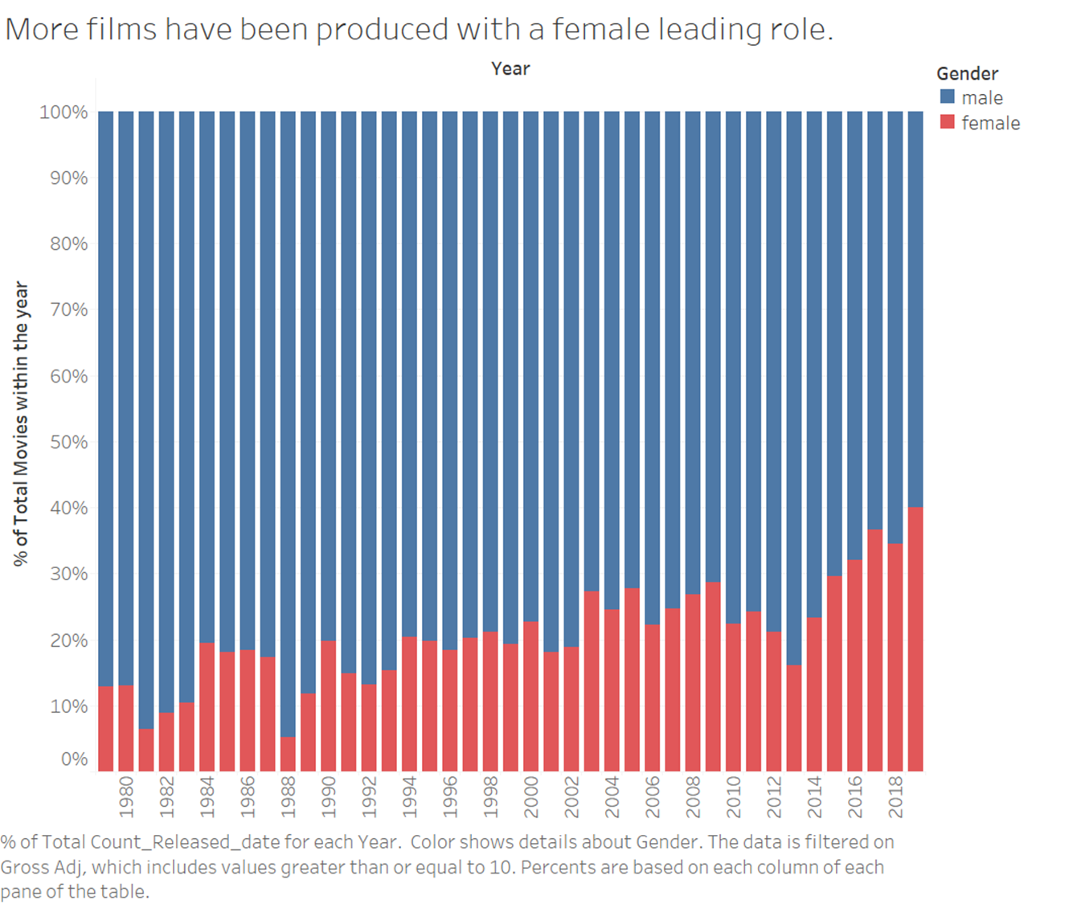
Background
Notes:
In the past 5 years, there is a trend in film industry that more films are produced with a single female character as the leading role. But is it just a fad influenced by feminism and its activists or there is an economic reason behind it? In other words, does the decision of a movie lead’s gender impact its expected box office?
In order to get to the bottom of this question, we decided to use a movie industry database to gain some insights.
More films have been produced with a female leading role.
Historically there has been more male led mvies
Past five years female led movies large increase
gender impact its expected box office?
Dataset

Slide 4


Hypothesis and Why Using Data?
Hypothesis:
Genders of movie leads have impact on movie revenue.
Why using Data?
Many factors affecting revenue
Common perception V.S. Data justification*
Notes:
Generally, factors related to films’ revenue may vary. Based on common perception, people may assume male-led movies produce more revenue than female-led movies because historically there were more male-led movies.
However, it is possible that male actors are simply more likely to be selected for movies producing high revenue or high budgets that lead to the success of movies.
Therefore, we need data and modeling to eliminate objective factors and exam the inner logic behind revenue discrepancy.

Slide 5


Ideal Experiment
Create a series pairs of two movies with the same qualities but different genders of the lead as follow:
Genres
Scripts
Directors
Two movie leads with same popularity and acting skill
Constructed in a similar way
Displayed in the same place
Notes:
Randomly determine factors for a movie (such as genre, script, and distributor)
Genres of movies are same
Scripts are same
Directors are same
Selected one actor and one actress with similar qualities (Same styles and same popularity)
Two movies are constructed in a similar way
Display two movies in the same place. Yet, randomize the audience.

Slide 6
Our Dataset
 | Variables | Description
Dependent Variable | Gross | Revenue of a movie (in million dollars); Adjusted by inflation rate; Revenue lower than 10 millions dollars were removed
Independent Variable | Gender | Gender of leading character of the movie
 | Budget | Budget of a movie (in million dollars); Adjusted by inflation rate;
 | Year | Releasing year of a movie; 1: 1980, 41: 2020
 | Scores | IMDB score of a movie; range: 0 - 10
 | Rating | Age limits of a movie G and PG; PG-13; R, NC-17 and others
 | Genres | Categories of a movie Adventures, action, comedy, drama movies, and others
Notes:
First we decided to investigate the distribution and the relationship between tgem

Slide 7
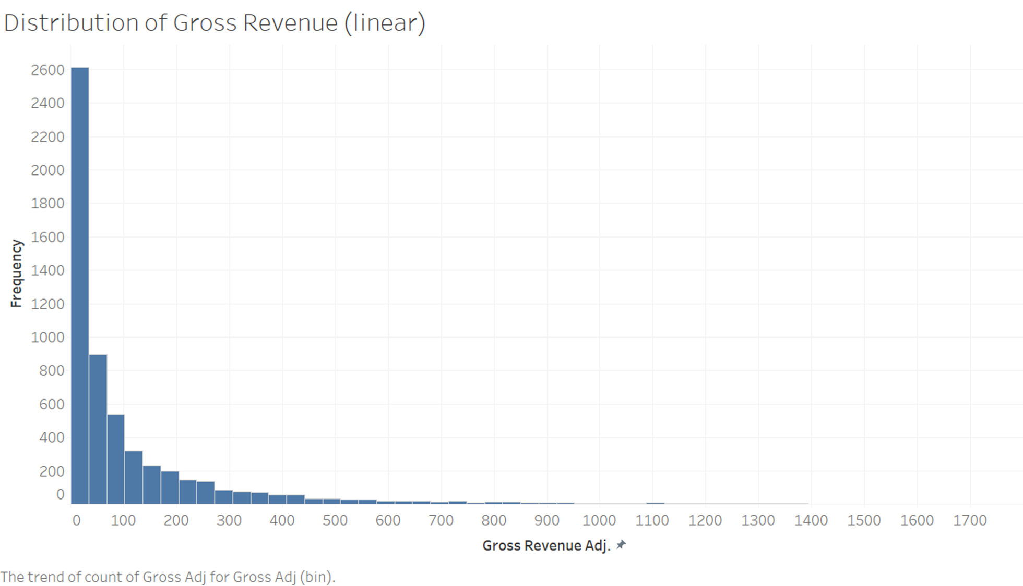
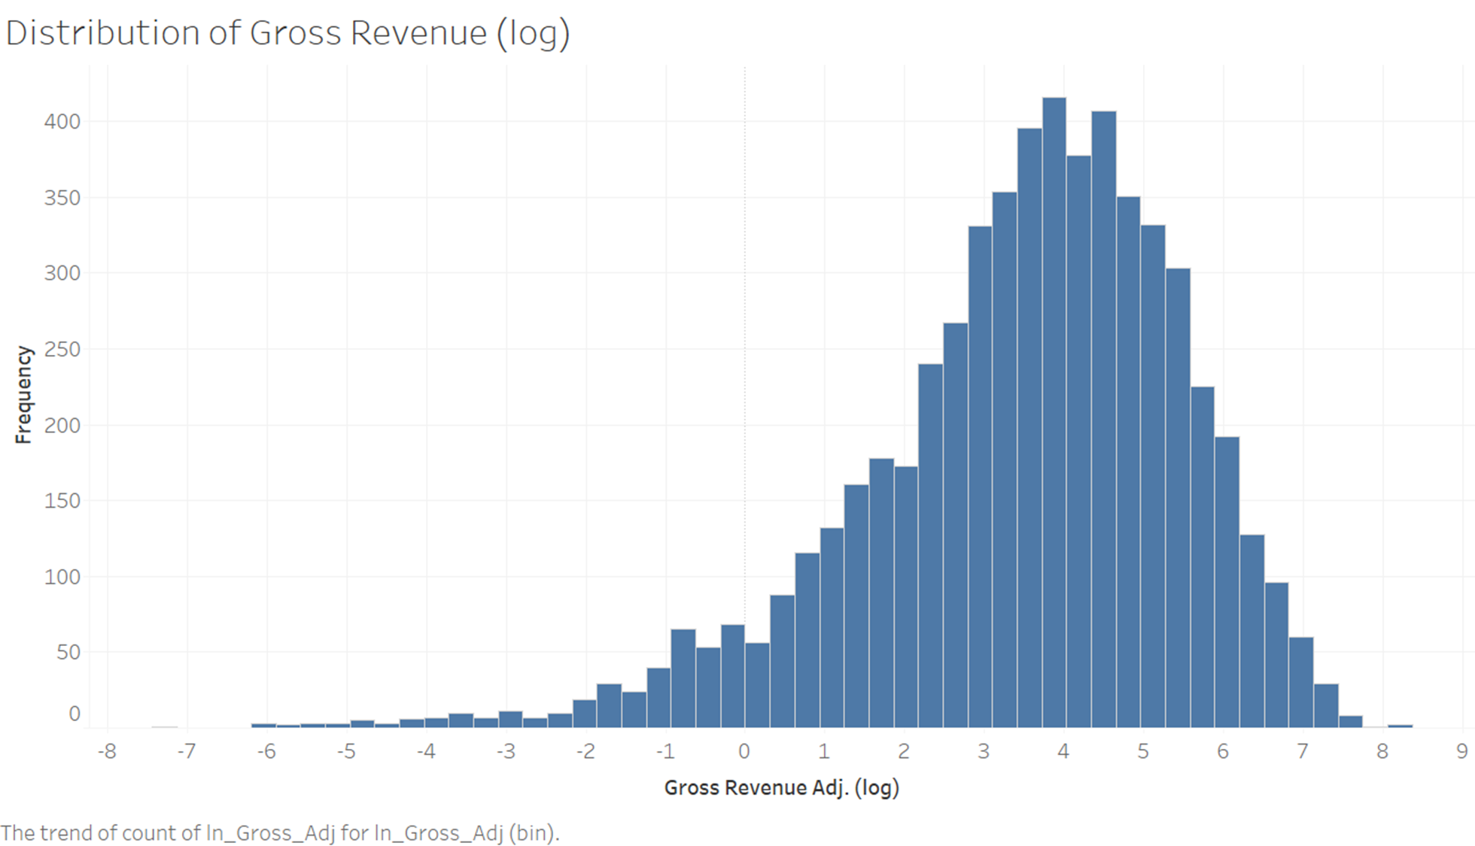
Revenue Distribution:
Highly right-skewed
Notes:
Why we log The original data set

Slide 8
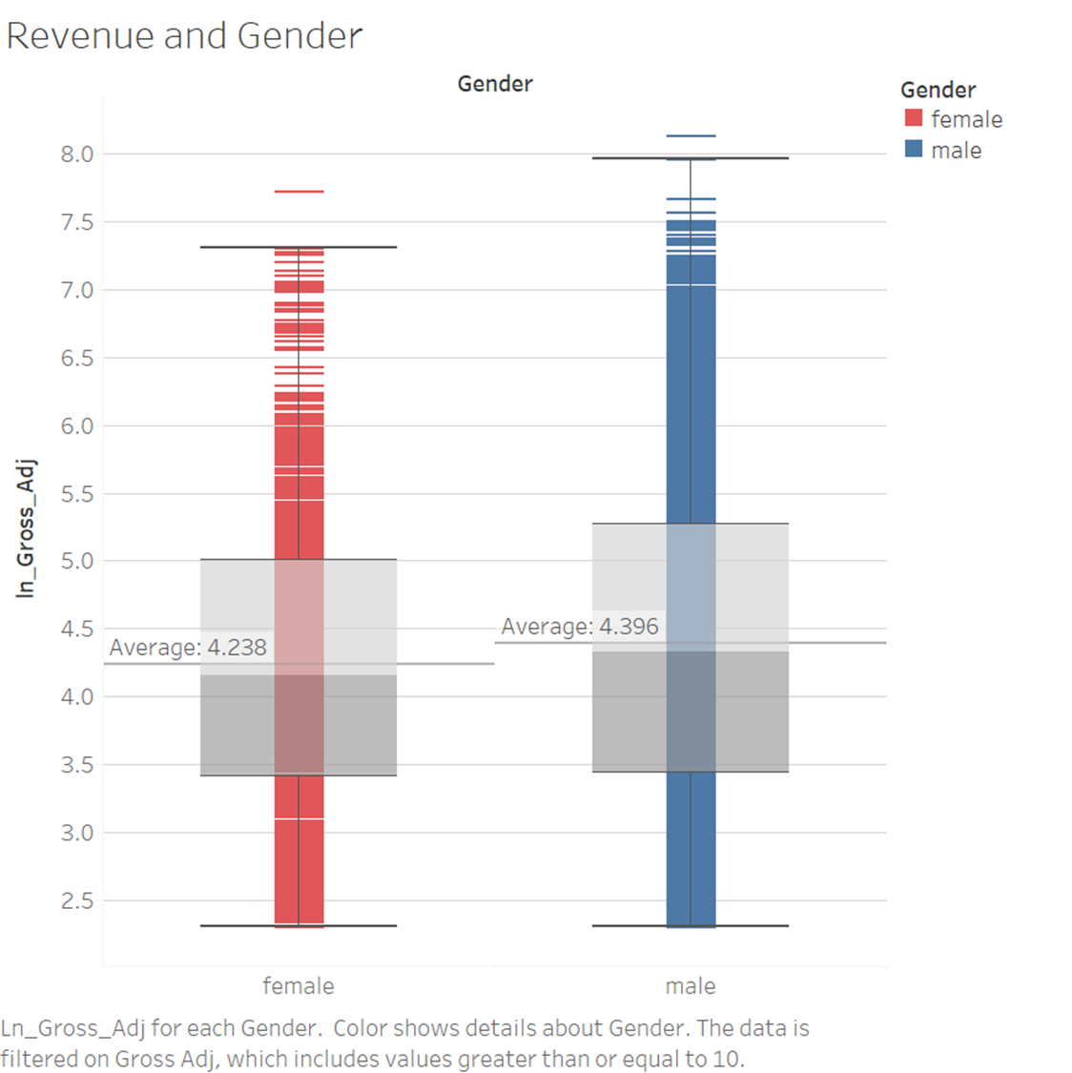
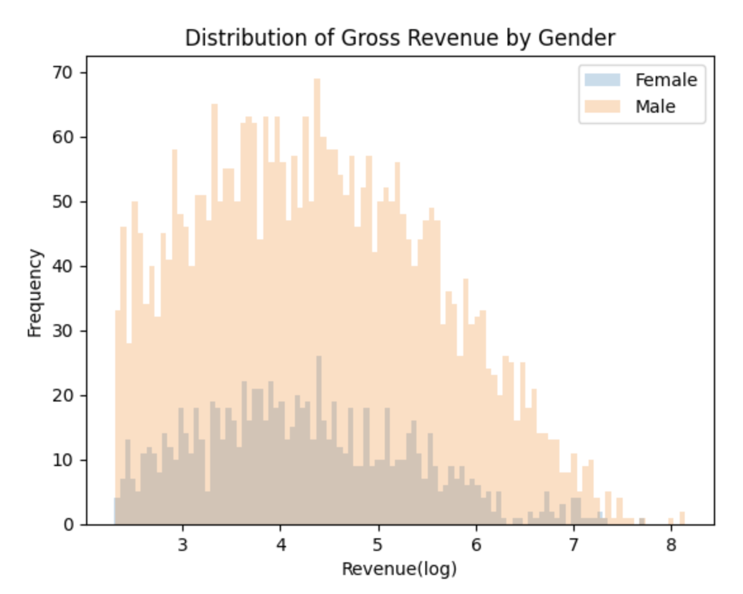
Revenue vs Gender:
Males’ revenue are higher than Females’ in general and on average.
There are less high revenue samples in female-lead movies
Notes:
Movies with Male leads generate more revenue than those with female leads.
There are less high revenue sample in the female lead movies

Slide 9
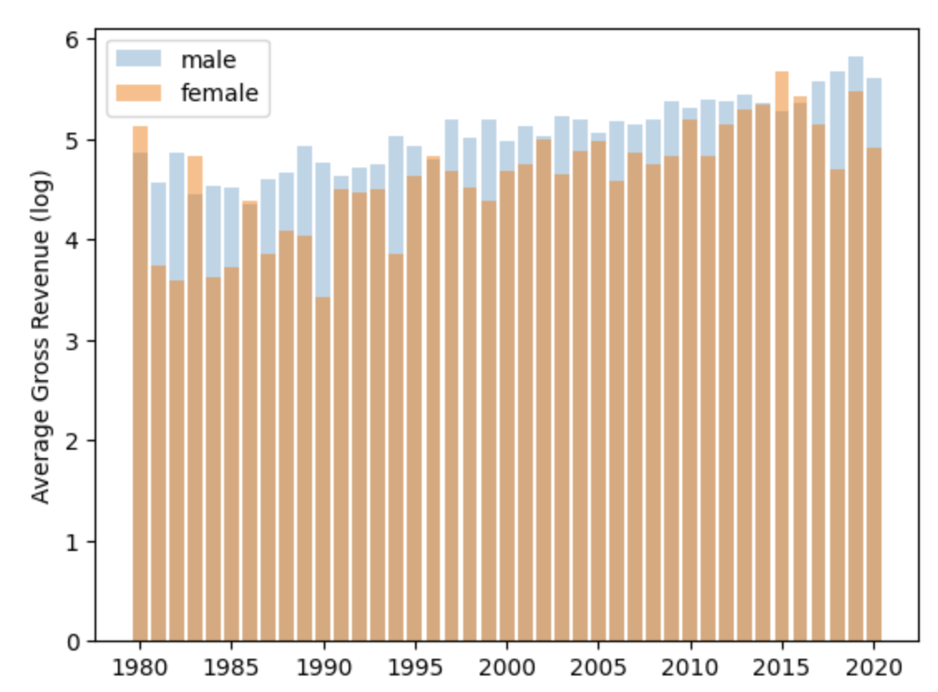
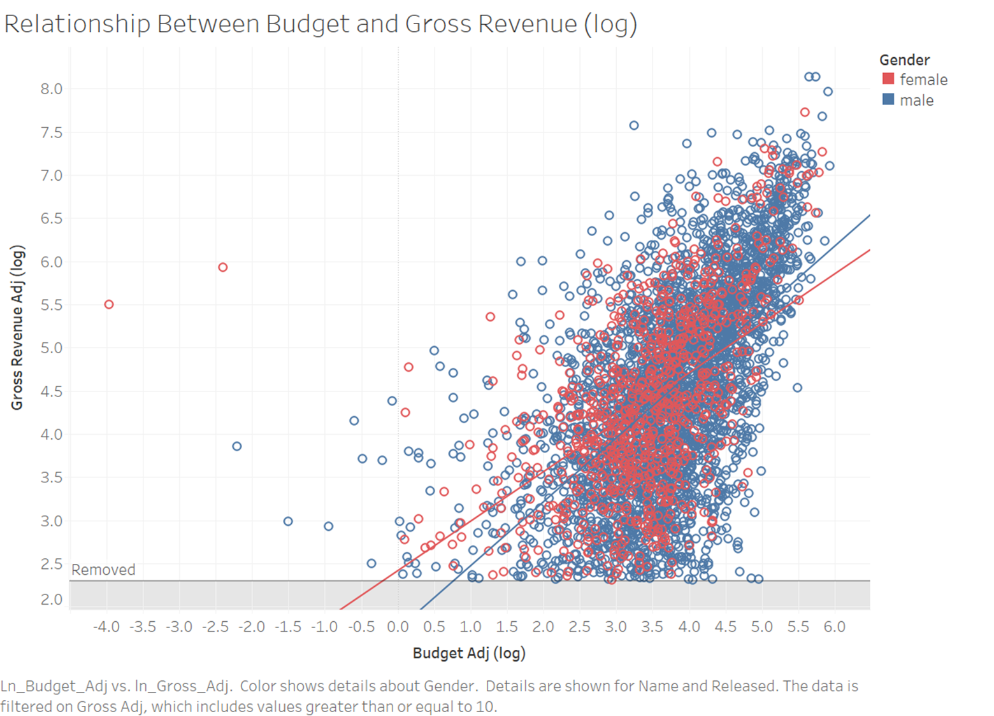
Revenue vs Budget: Revenue vs Year:
Positive
Determine potential
Inflation adjusted
Notes:
However, there is also effect from theatres and stuffs
Relationship positive
Budget adj: budget of a movie determines its potential (adjusted by inflation)
After we adjust inflation, we still see some relationship between year and revenue

Slide 10
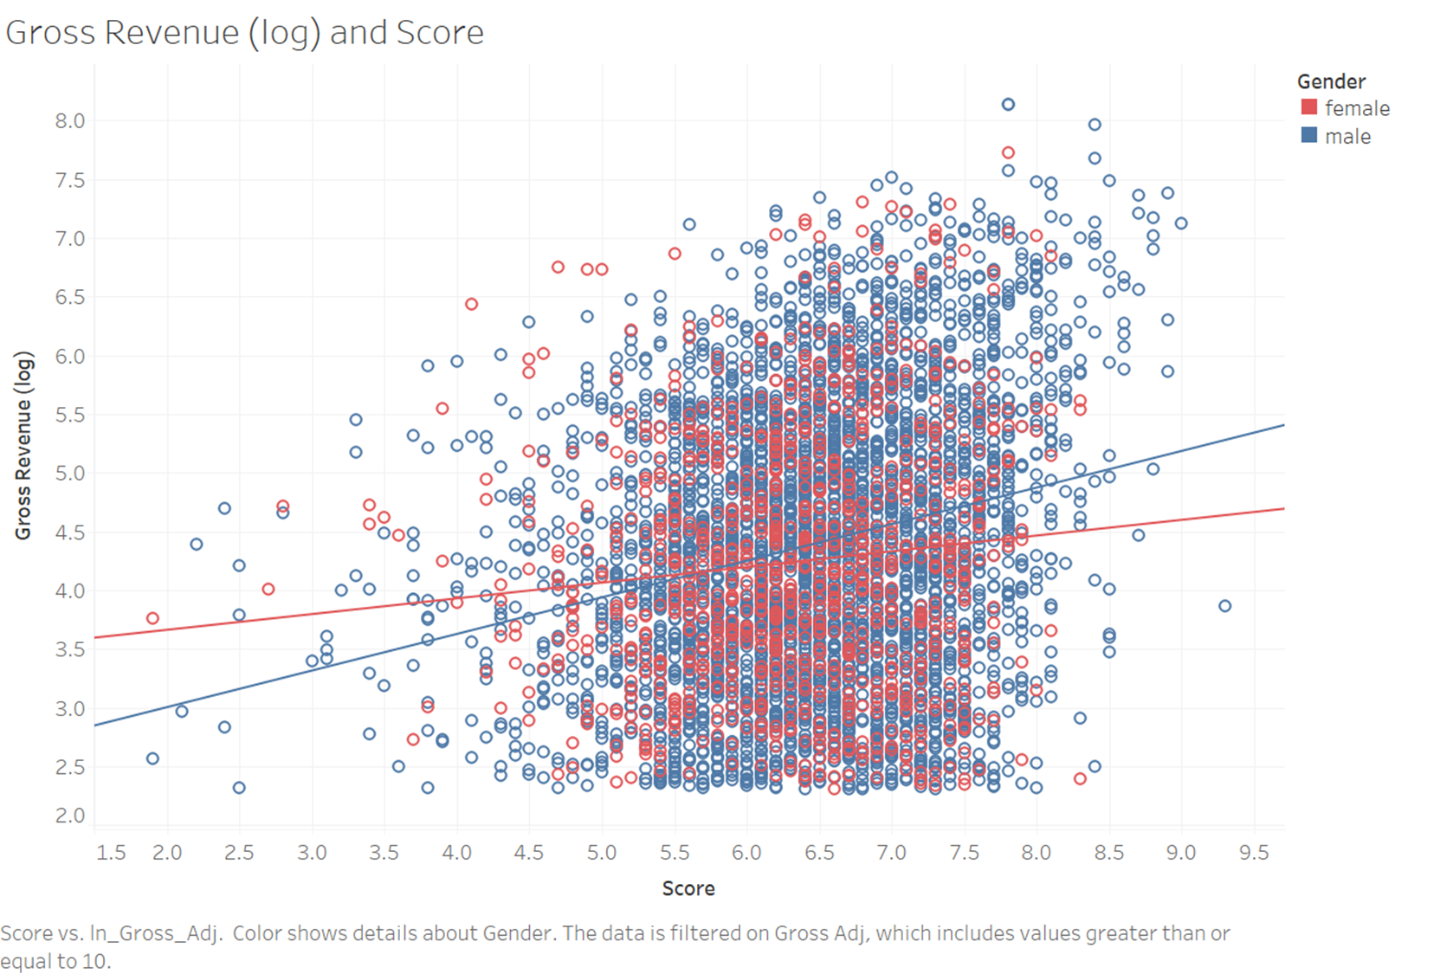
Revenue vs Score:
Quality of a movie
Notes:
The regression looks Correlated
Scores: measures quality of a movie
It is also worth checking if male-led movies are better in quality than female-lead movies, as if that’s the case, it might provide a more logical explanation why male-led movies make more money.

Slide 11
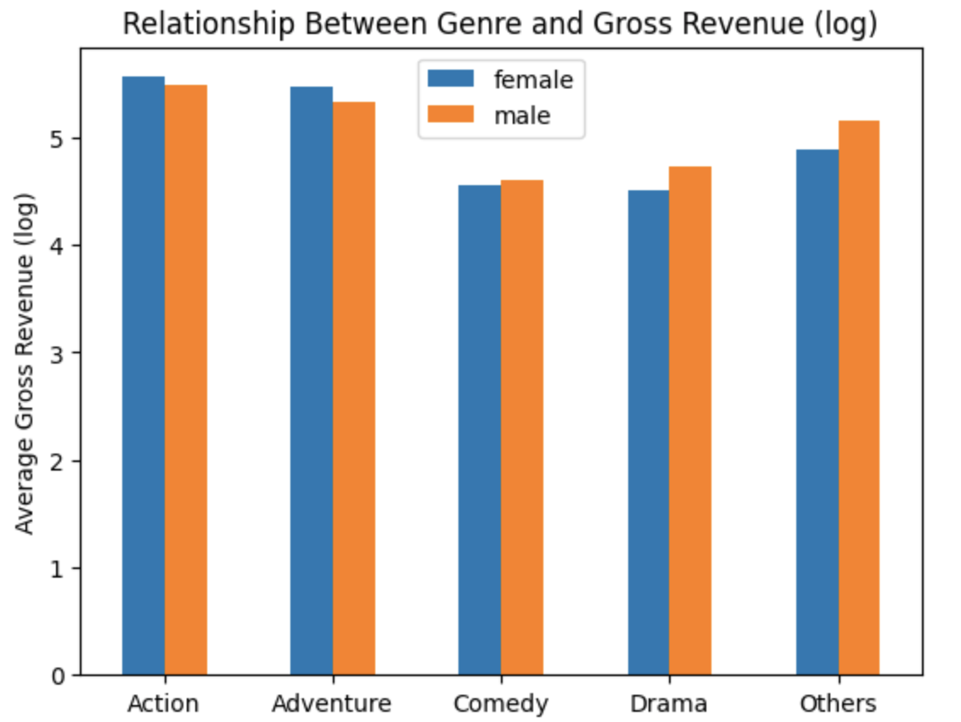
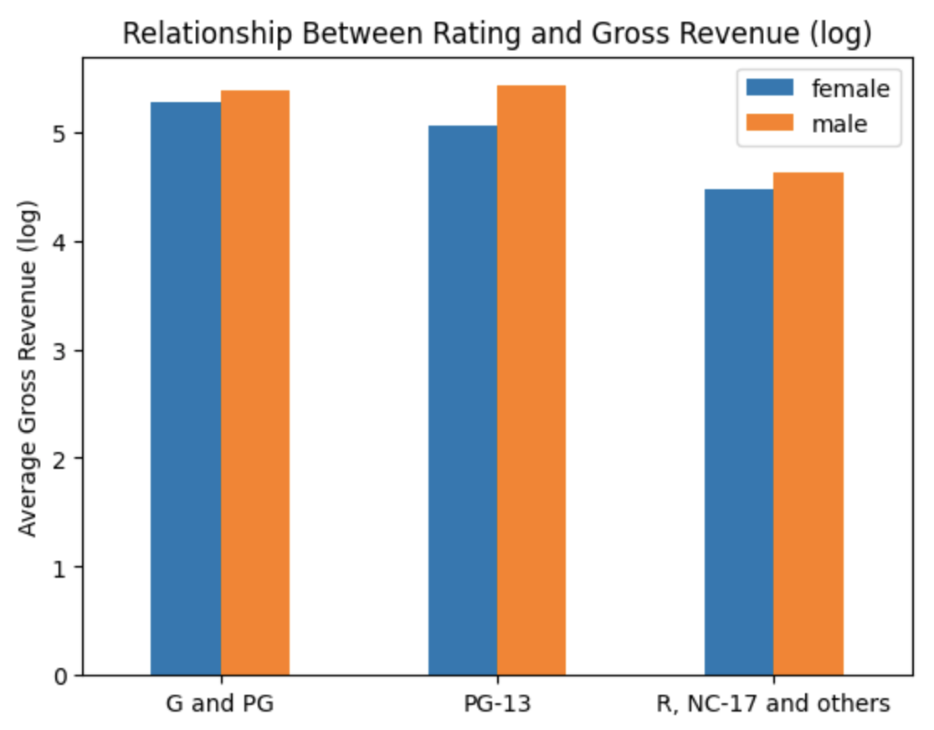
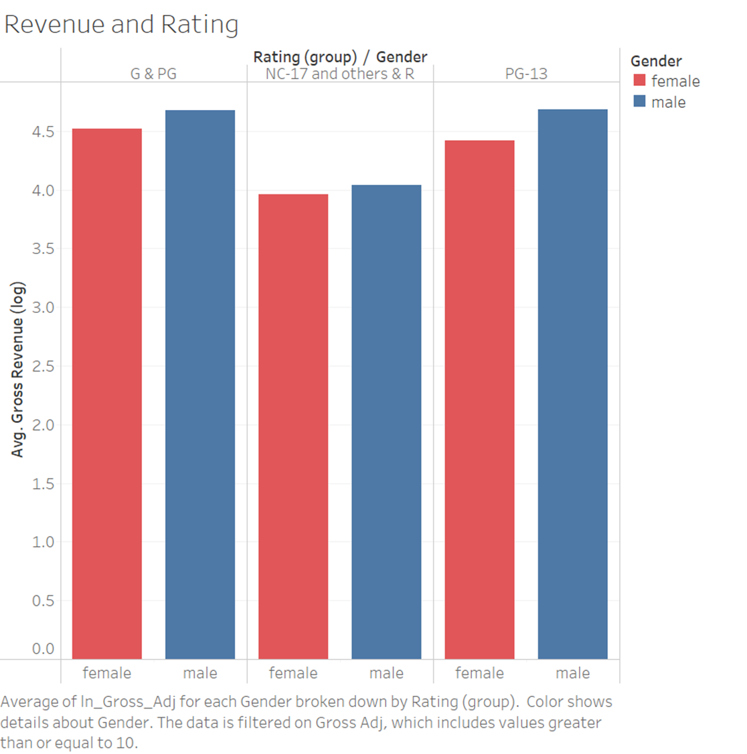
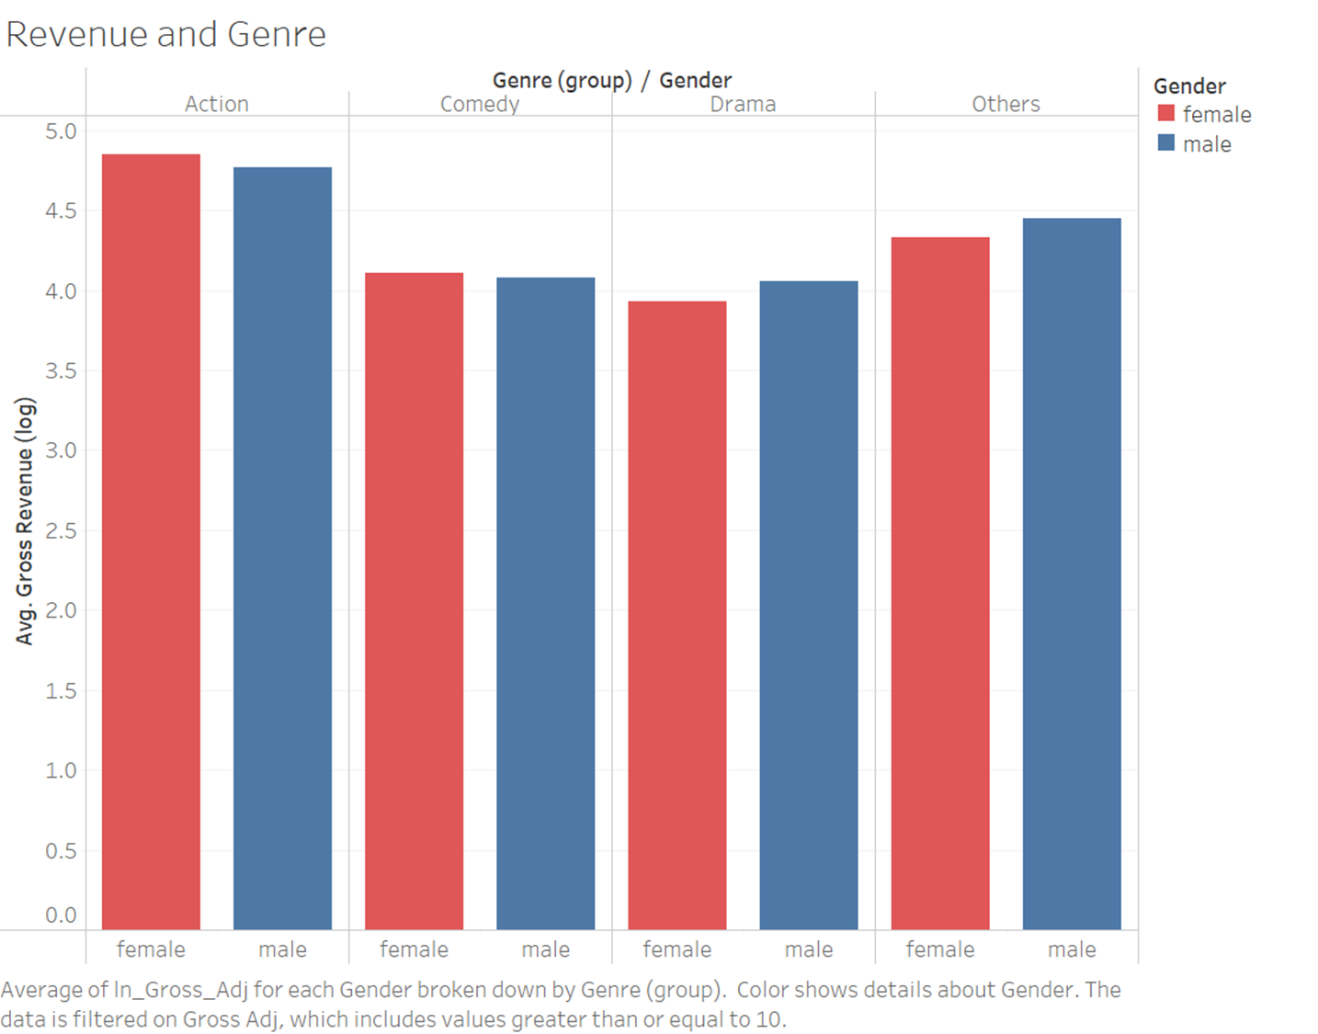
Revenue vs Genre:
Revenue vs Rating:
Grouped categories
Limits targeted audience
Different average revenues for different categories
Notes:
Explain why control genre
For the genre and rating variables
group them
make their weights comparable
the average revenue for different genres and rating are different
Rating: limits targeted audience of a movie
Pass to gabriel
Summarise our control variables
Explain our model

Slide 12
Model and Interpretation

Slide 13
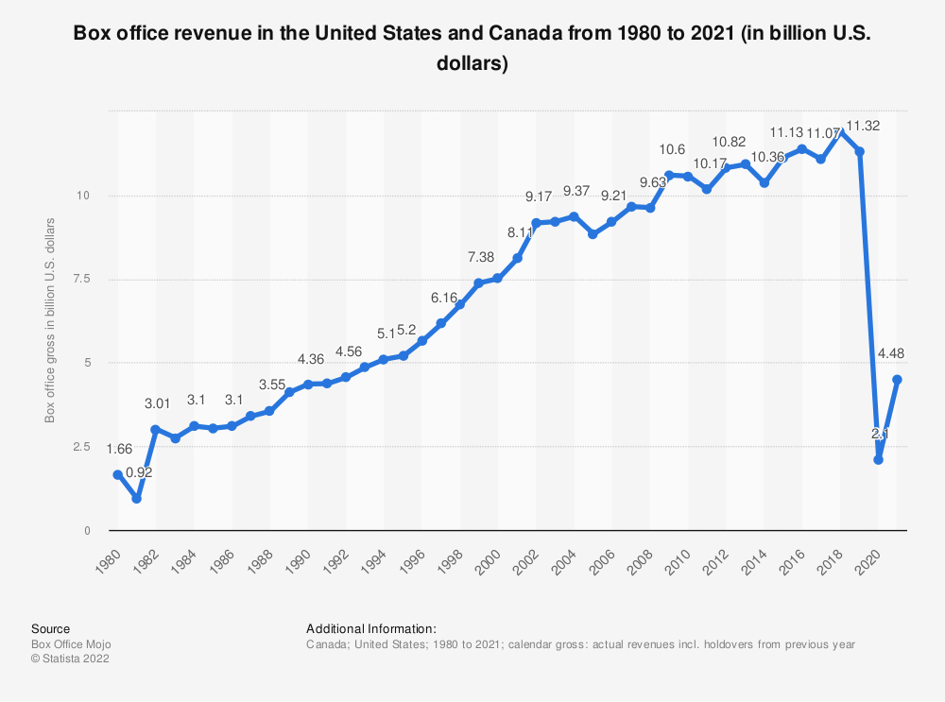
Control Variables
Budget adj: budget of a movie determines its potential (adjusted by inflation)
Year: movies industry has been growing in the last 40 years
Scores: measures quality of a movie Rating: limits targeted audience of a movie
Genres: adventures, action, comedy, drama movies have the highest box office revenue in the North America market
Notes:
Here’s the recap of our control variables. According to results of descriptive analysis and external information, we will include those variables in our model.

Slide 14
ln(gross) ~ ln(budget) + year + score
+ rating + genre
OLS Regression Results
R-squared | 0.441 | Adj. R-squared | 0.440
F-statistic | 340.2 | Prob (F-statistic) | 0.00
Without gender
Adj. R-squared: 0.440
 | Coefficient | P-Value
Intercept | 0.0793 | 0.536
Rating[PG-13] | -0.1644 | 0.000
Rating[R, NC and Others] | -0.4581 | 0.000
Genre[Adventure] | -0.1921 | 0.003
Genre[Comedy] | -0.1729 | 0.000
Genre[Drama] | -0.3357 | 0.000
Genre[Others] | -0.1207 | 0.004
ln(Budget) | 0.5999 | 0.000
Year | 0.0163 | 0.000
Score | 0.3451 | 0.000
Notes:
We start the model without including gender.

Slide 15
ln(gross) ~ gender + ln(budget) + year + score + rating + genre
OLS Regression Results
R-squared | 0.443 | Adj. R-squared | 0.441
F-statistic | 308.2 | Prob (F-statistic) | 0.00
Gender:
coef = -0.1230 (p-value=0.001)
Controlling other variables, male-lead movies make 11.57% less revenue compared to female-leads movies
Adj. R-squared changes little
The relationships between revenue and control variables are the same
 | Coefficient | P-Value
Intercept | 0.1578 | 0.225
Gender[Male] | -0.1230 | 0.001
Rating[PG-13] | -0.1720 | 0.000
Rating[R, NC and Others] | -0.4600 | 0.000
Genre[Adventure] | -0.2002 | 0.002
Genre[Comedy] | -0.1897 | 0.000
Genre[Drama] | -0.3588 | 0.000
Genre[Others] | -0.1346 | 0.001
ln(Budget) | 0.6054 | 0.000
Year | 0.0157 | 0.000
Score | 0.3462 | 0.000
Notes:
The results is opposite to common perception that male leads movie produce more revenue than female, under the same conditions.
If combined with other factors, how gender affects revenue

Slide 16
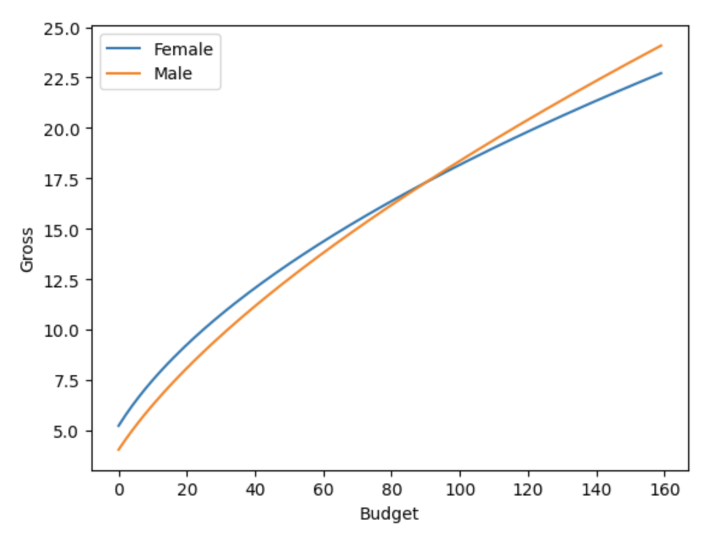
ln(gross) ~ gender + gender * ln(budget)
+ ln(budget) + year + score + rating + genre
OLS Regression Results
R-squared | 0.444 | Adj. R-squared | 0.443
F-statistic | 281.8 | Prob (F-statistic) | 0.00
Gender * ln(budget):
coef = 0.1117 (p-value=0.002)
= 0.1117% more rev per 1%
 | Coefficient | P-Value
Intercept | 0.4576 | 0.004
Gender[Male] | -0.5145 | 0.000
Gender[Male]*ln(Budget) | 0.1117 | 0.002
Rating[PG-13] | -0.1725 | 0.000
Rating[R, NC and Others] | -0.4562 | 0.000
Genre[Adventure] | -0.1941 | 0.003
Genre[Comedy] | -0.1837 | 0.000
Genre[Drama] | -0.3551 | 0.000
Genre[Others] | -0.1342 | 0.001
ln(Budget) | 0.5196 | 0.000
Year | 0.0154 | 0.000
Score | 0.3456 | 0.000
Notes:
Efficiency of transforming budget into revenue is different for male and female leads movies.
If budget has different effect on revenue depending on the of value gender.
But when we consider the interaction term, we can see that for 1% increase in budget, the male will make 0.1117% more revenue.
For movies with million of budget, the interaction number might outweigh the gender coefficient.
However the coefficient of interaction term between male and log budget is positive,
Intersection point
Male will generate more revenue than female when the budget is 99.97 millions or higher. (Percentile 86)

Slide 17
ln(gross) ~ gender + gender * score
+ ln(budget) + year + score + rating + genre
OLS Regression Results
R-squared | 0.447 | Adj. R-squared | 0.446
F-statistic | 261.7 | Prob (F-statistic) | 0.00
Gender:
coef = -1.2699 (p-value=0.000)
Gender * score:
coef = 0.1813 (p-value=0.000)
Male will generate more revenue than female when the score is 7 or higher. (percentile 72)
 | Coefficient | P-Value
Intercept | 1.0999 | 0.000
Gender[Male] | -1.2699 | 0.000
Gender[Male]*score | 0.1813 | 0.000
Rating[PG-13] | -0.1870 | 0.000
Rating[R, NC and Others] | -0.4754 | 0.000
Genre[Adventure] | -0.2072 | 0.002
Genre[Comedy] | -0.1944 | 0.000
Genre[Drama] | -0.3593 | 0.000
Genre[Others] | -0.1430 | 0.001
ln(Budget) | 0.6030 | 0.000
Year | 0.0159 | 0.000
Score | 0.1998 | 0.000
Notes:
Gender affect revenue through quality of the movie. Gender Transforming high quality movies into high revenue
If the movie is male-lead, we will expect 71.91% decrease of revenue than female-lead

Slide 18
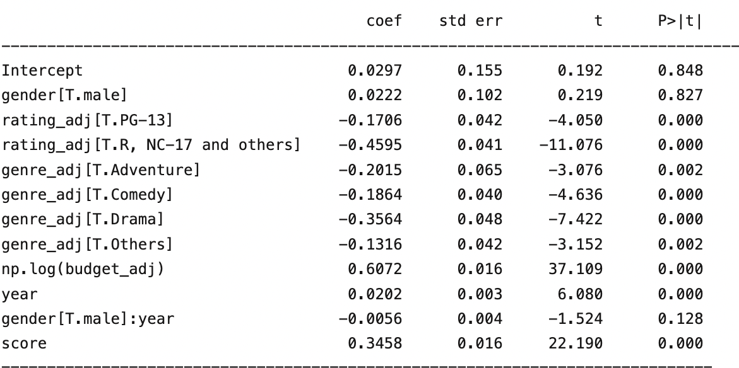

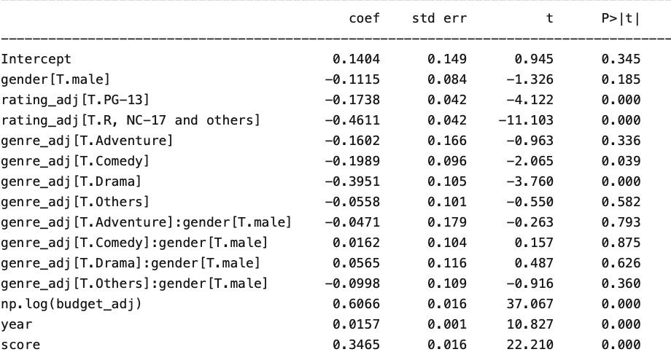
Other Interaction Terms: Insignificant (P-value >0.05)
ln(gross) ~ gender + gender * year
+ ln(budget) + year + score + rating + genre
ln(gross) ~ gender + gender * genre
+ ln(budget) + year + score + rating + genre
Notes:
Audience preference towards gender might change by years and genres. Therefore we added two interaction terms to investigate if that’s the case.
Both P-value insignificant, so we conclude that Audience preference towards gender doesn’t change by years or genres

Slide 19
Conclusions and Limitations

Slide 20
Limitations
We didn’t control for these things
Effects from people
Cast List
Director
Producer
Composer
Cinematographer
Distributor
Movie Title
Social Factor (Youtube, Tweets, Wikipedia)
Score and Budget can be a proxy everything else (e.g. Director, Cast, Producer). However, we do not know the separated effect from each of them.
We do not have a lot of big name female movies (high-budget & high-score) in comparison to male movies.
Big name male movies:
Titanic, Avengers, Pirate of the Caribbean, etc.
Big name female movies:
Star Wars 7-9
Notes:
Due to the limitation of our dataset, our model doesn’t include factors like cast list, director, producer, composer, cinematographer, and distributor, which can also have an impact on the movie revenue. Score and budget can be a proxy for everything else. For example, a movie with a higher budget can have a better chance to attract a famous director and better casts. However, it’s very difficult for us to measure the effect independently. We also notice that our dataset doesn’t have a comparable number of samples for big-name female lead movies as for male lead movies. For example, big-name male movies include Titanic, Avengers, Pirate of the Caribbean and so on, but we only have a few big-name female movies like Star Wars 7-9. Besides, it’s difficult for us to take the influence of social media into consideration, such as YouTube, Instagram, TikTok and so on, which can also affect the popularity of movies and thus affect the box office of movies.

Slide 21
Conclusions:
Gender does affect the revenue.
Controlling all other variables, movies with male leads seem to generate 11.57% less revenue.
The slopes for gender with budget and gender with score are significant.
Within top 14th percentile budget, male led movies tend to generate more revenue
Within top 28th percentile score, male led movies tend to generate more revenue
Notes:
In conclusion, we believe that gender does affect the revenue with significant p-value and increasing adjusted r-square as shown by our models. Controlling all other variables, we can conclude that movies with male leads seem to generate less revenue than movies with female leads. However, after we add the interaction term for gender and budget, we notice that males will generate more revenue than females when the budget is 99.97 million or higher, and when budget is lower, female lead movies outperform male lead movies. According to our model, the slope of the interaction term for gender and score is also significant. In consideration of the above two interaction terms, we can draw a conclusion that male lead movies tend to generate more revenue with higher budget and higher scores.

Slide 22
Thank you
The Effect of Movie Lead’s Gender on Movie’s Revenue

